Slide 1
Chinook music store project By ankur Choudhary
\

Slide 2
About chinook
Chinook Music Services is a premier brand in the physical music records market, dedicated to delivering musical entertainment worldwide. With a global network of outlets and services, Chinook offers a comprehensive genre experience to its customers, ensuring diverse musical enjoyment for all.

Slide 3
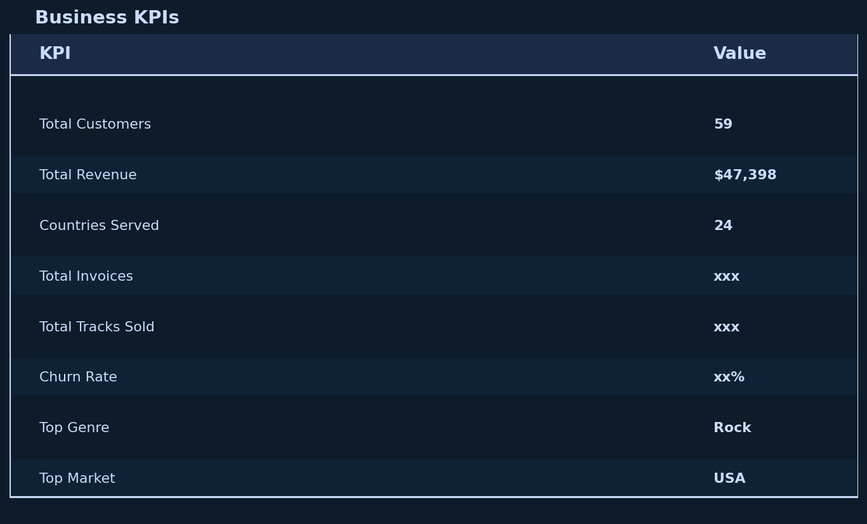
KPI

Slide 4
Executive Summary
Key Findings
Rock is the dominant genre in USA and globally.
USA contributes highest revenue and customer count.
Czech Republic shows high revenue potential despite low customer count.
22 customers are inactive for more than 3 months.
Cross-selling opportunities exist within Rock, Metal, and Alternative & Punk genres.
Business Recommendations
Increase marketing in high-value regions.
Launch win-back campaigns for inactive customers.
Promote Rock albums and artists aggressively.
Expand customer acquisition in underrepresented countries.
This immediately makes the report look professional.

Slide 5
Problem Statement
Chinook Music Services is a premier brand in the physical music records market, dedicated to delivering musical entertainment worldwide. With a global network of outlets and services, Chinook offers a comprehensive genre experience to its customers, ensuring diverse musical enjoyment for all.

Slide 6
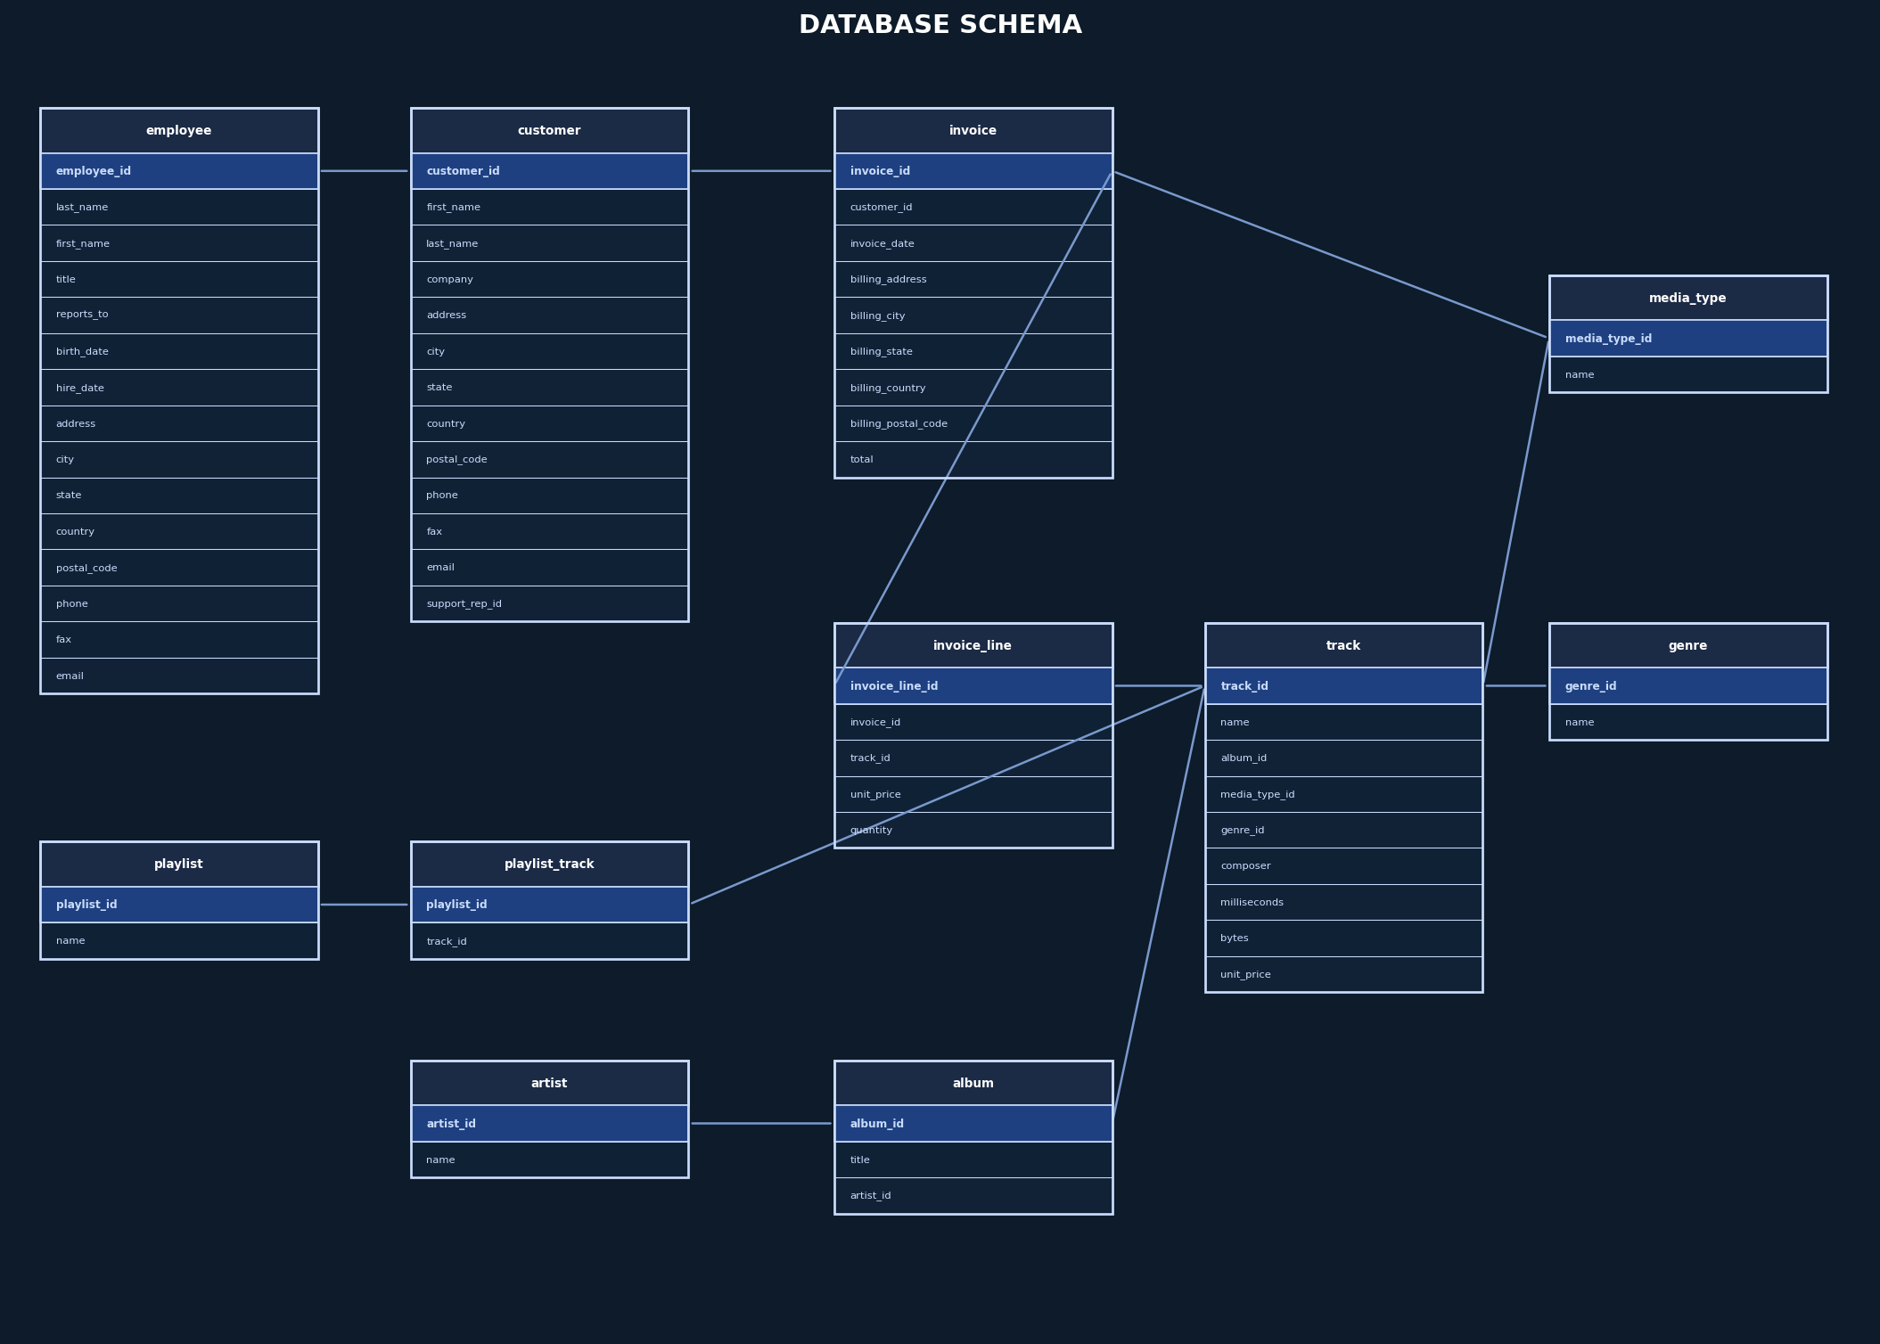
Data schema
Problem Statement

Slide 7
Data description
customer:
customer_id: Unique identifier assigned to each customer.
first_name: The given name or first name of a customer.
last_name: The surname or family name of a customer.
company: The name of the company associated with a customer.
address: The street address of a customer's location.
city: The city where a customer is located.
state: The state or province where a customer is located.
country: The country where a customer is located.
postal_code: The postal or zip code of a customer's address.
phone: The phone number of a customer.
fax: The fax number associated with a customer.
email: The email address of a customer.
support_rep_id: The employee ID of the support representative assigned to a customer.
invoice:
invoice_id: Unique identifier assigned to each invoice.
customer_id: The customer ID associated with the invoice.
invoice_date: The date when the invoice was generated or issued.
billing_address: The street address used for billing purposes.
billing_city: The city used for billing purposes.
billing_state: The state or province used for billing purposes.
billing_country: The country used for billing purposes.
billing_postal_code: The postal or zip code used for billing purposes.
total: The total amount due on the invoice.

Slide 8
Data description(continued)
invoice:
invoice_id: Unique identifier assigned to each invoice.
customer_id: The customer ID associated with the invoice.
invoice_date: The date when the invoice was generated or issued.
billing_address: The street address used for billing purposes.
billing_city: The city used for billing purposes.
billing_state: The state or province used for billing purposes.
billing_country: The country used for billing purposes.
billing_postal_code: The postal or zip code used for billing purposes.
total: The total amount due on the invoice.
invoice_line:
invoice_line_id: Unique identifier assigned to each line item on an invoice.
invoice_id: The invoice ID to which the line item belongs.
track_id: The ID of the track or product included in the line item.
unit_price: The price per unit for the line item.
quantity: The quantity of units for the line item.
playlist:
playlist_id: Unique identifier assigned to each playlist.
name: The name or title of the playlist.
playlist_track:
playlist_id: The ID of the playlist to which the track belongs.
track_id: The ID of the track included in the playlist.
track:
track_id: Unique identifier assigned to each track or song.
name: The title or name of the track.
album_id: The ID of the album to which the track belongs.
media_type_id: The ID of the media type associated with the track.
genre_id: The ID of the genre associated with the track.
composer: The name of the composer or artist who composed the track.
milliseconds: The duration of the track in milliseconds.
bytes: The file size of the track in bytes.
unit_price: The price per unit for the track.

Slide 9
Data description(continued)
album:
album_id: Unique identifier assigned to each album.
title: The title or name of the album.
artist_id: The ID of the artist associated with the album.
artist:
artist_id: Unique identifier assigned to each artist.
name: The name of the artist.
media_type:
media_type_id: Unique identifier assigned to each media type.
name: The name or description of the media type (e.g., MPEG audio file, AAC audio file).
genre:
genre_id: Unique identifier assigned to each genre.
name: The name or description of the genre (e.g., rock, pop, classical).

Slide 10
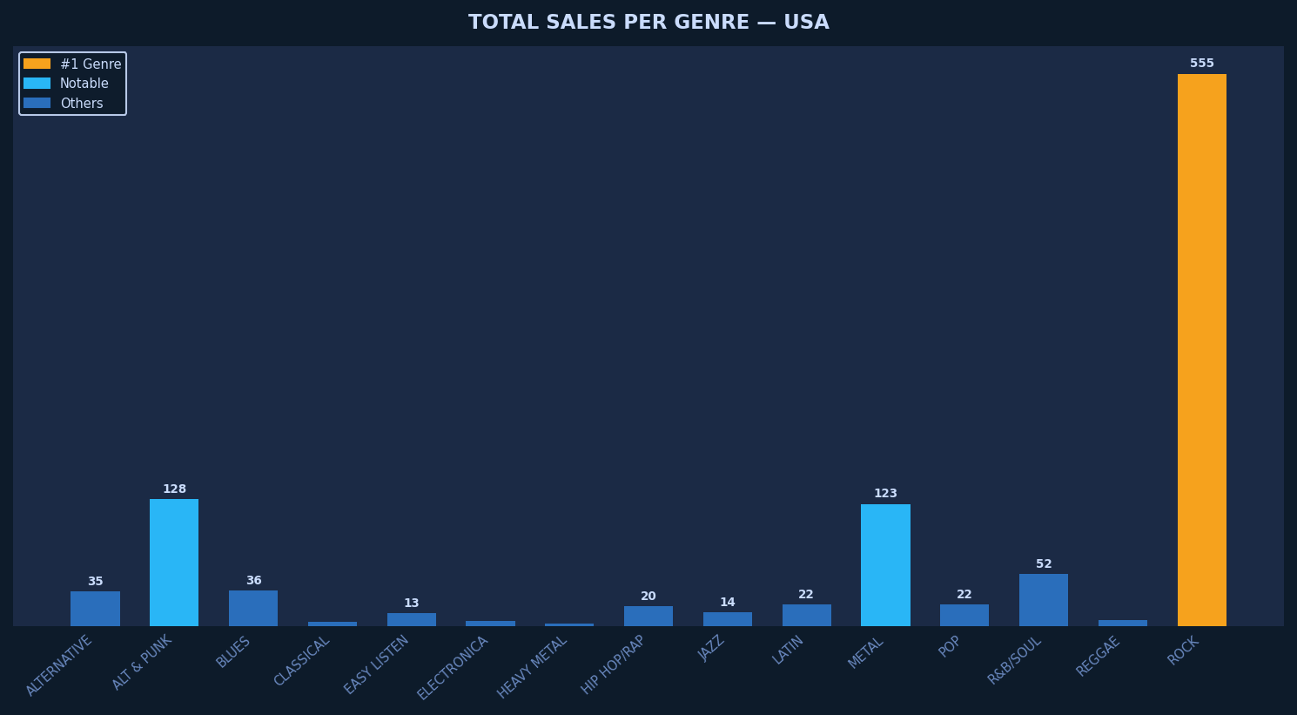
Most popular genres in America based on sales
The most popular genre in the USA is Rock.
After Rock, Alternative & Punk and Metal are the most popular genres.
Based on this, Rock albums and Rock artists should be advertised. Metal and Alternative & Punk should also be promoted.
For genres like Blues and R&B/Soul, they should be sold on exclusive deals to frequent buyers of these genres.

Slide 11
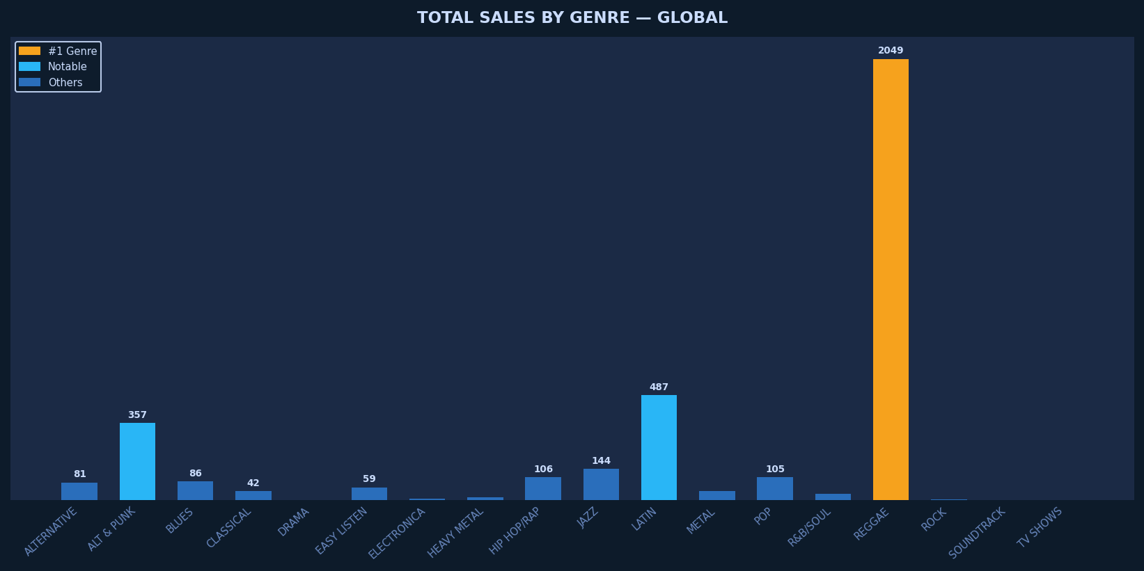
Most popular genres outside America based on sales
Just like the USA, the most popular genre outside USA based on sales is Rock
Outside America, Metal is more popular than Alternative & Punk, but both are similarly popular after Rock like in America.
Outside America, Latin is more popular than R&B/Soul and Jazz is more popular than Blues.
Rock should be advertised the highest because of its massive lead in total sales.
Metal and Alternative & Punk should be promoted.
Latin, Jazz and R&B/Soul should be sold on discounts to frequent buyers.

Slide 12
Affinity analysis
genre_1 Rock | genre_2 Rock | times_bought_together 19182
Alternative & Punk | Alternative & Punk | 2532
Metal | Metal | 2116
Rock | Metal | 1610
Metal | Rock | 1610
Alternative & Punk | Rock | 1045
Rock | Alternative & Punk | 1045
R&B/Soul | R&B/Soul | 842
Blues | Blues | 776
Latin | Latin | 764
album_1 Are You Experienced? | album_2 Are You Experienced? | times_bought_together 2118
Greatest Hits I | Greatest Hits I | 786
Get Born | Get Born | 626
Pure Cult: The Best Of The Cult (For Rockers, Ravers, Lovers & Sinners) [uk] | Pure Cult: The Best Of The Cult (For Rockers, Ravers, Lovers & Sinners) [uk] | 612
Barulhinho Bom | Barulhinho Bom | 612
The Cream Of Clapton | The Cream Of Clapton | 580
Faceless | Faceless | 574
My Way: The Best Of Frank Sinatra [Disc 1] | My Way: The Best Of Frank Sinatra [Disc 1] | 554
Miles Ahead | Miles Ahead | 546
News Of The World | News Of The World | 530
Speaking of a genre that was bought together with another genre, Rock was bought with Rock most number of times. So cross-selling initiatives should be taken for people who buy Rock tracks together.
Speaking of album affinity, tracks from the same album were bought the top ten times, so discount on full albums should be promoted.

Slide 13
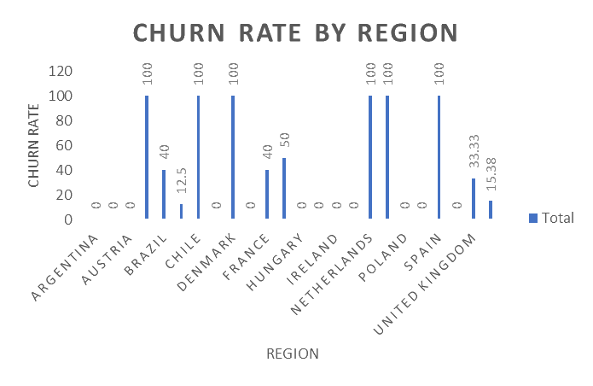
Churn rates by region
Speaking of countries having a decent number of total customers, Canada has the lowest churn rate
USA has the highest number of total customers, and a decent churn rate of 15.38
Germany has 4 customers out of which 2 are churned, which can be considered concerning.
France/Brazil have a churn rate of 40, which should be checked
There are countries with 100 percent churn rate but that does not tell a lot because they had only one customer.
Similarly, there are countries with 0 churn rate but that does not tell a lot either because they have only 1 or 2 customers.

Slide 14
Region wise purchase behavior
region USA | total_customers 13 | total_orders 131 | total_revenue 1040.49 | avg_order_value 7.94 | avg_purchase_frequency 10.08
Canada | 8 | 76 | 535.59 | 7.05 | 9.50
Brazil | 5 | 61 | 427.68 | 7.01 | 12.20
France | 5 | 50 | 389.07 | 7.78 | 10.00
Germany | 4 | 41 | 334.62 | 8.16 | 10.25
Czech Republic | 2 | 30 | 273.24 | 9.11 | 15.00
United Kingdom | 3 | 28 | 245.52 | 8.77 | 9.33
Portugal | 2 | 29 | 185.13 | 6.38 | 14.50
India | 2 | 21 | 183.15 | 8.72 | 10.50
Ireland | 1 | 13 | 114.84 | 8.83 | 13.00
Spain | 1 | 11 | 98.01 | 8.91 | 11.00
Chile | 1 | 13 | 97.02 | 7.46 | 13.00
Australia | 1 | 10 | 81.18 | 8.12 | 10.00
Finland | 1 | 11 | 79.20 | 7.20 | 11.00
Hungary | 1 | 10 | 78.21 | 7.82 | 10.00
Poland | 1 | 10 | 76.23 | 7.62 | 10.00
Sweden | 1 | 10 | 75.24 | 7.52 | 10.00
Norway | 1 | 9 | 72.27 | 8.03 | 9.00
Austria | 1 | 9 | 69.30 | 7.70 | 9.00
Netherlands | 1 | 10 | 65.34 | 6.53 | 10.00
Belgium | 1 | 7 | 60.39 | 8.63 | 7.00
Italy | 1 | 9 | 50.49 | 5.61 | 9.00
USA has the highest total revenue, total orders and total customers.
Czech Republic has performed really well considering average order value per invoice and average purchase frequency per customer (number of invoices per customer), even though it only has 2 customers.
There should be advertisements and special deals for countries with only 1 or 2 customers to promote more engagement.

Slide 15
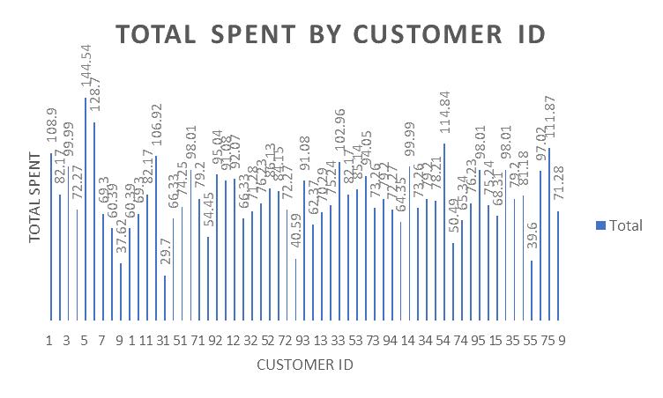
Customer segments based on purchase history
Customers were segmentized based on frequency (average days between purchases), total spent and total purchases (high value, low value and moderate value), and churn
status (active, churned, at risk).
Most customers who are churned belong to the moderate value segment.
Customers belonging to the high value segment are usually active.
Most customers belong to the high frequency segment.
None of the customers belonging to the low frequency or moderate frequency segments are churned. This can be because buying after a lot of days made their latest order date in the past 6 months.

Slide 16

recommendations
Exclusive deals and advertisements in countries with less total customers.
Cross-selling initiatives, especially in popular genres like rock where people buy multiple tracks. Discounts on full albums.
Win back discounts and incentives for churned customers, retention campaigns (like points system, exciting deals) for at risk customers, and loyalty programs for active customers (like personal offers).
Survey feedbacks for countries with high churn rates.
Advertisement of tracks/albums which have lesser reach (distinct customers) but high total sales.

Slide 17
conclusion
Major work needs to be done on the countries with 1 or 2 customers to increase engagement.
Countries like Czech Republic should be given priority because of less customers but high potential.
Focus on Rock should be kept the highest, be it cross-selling or advertising.
By leveraging these insights, the company can optimize marketing efforts, improve customer retention, and increase profitability. Implementing the recommendations will drive data-driven decision-making for long-term success

Slide 18

Thank You

